Slide 1

Mawlana Bhashani Science and Technology University
Course Title: Wireless and Mobile Communication
Course Code: ICT-4201
Topic: NFC(Near Field Communication)
Submitted By,
Md. Shahidul Islam
ID:IT-21024 Dept. of ICT, MBSTU
Supervised By,
Md. Nazrul Islam
Associate Professor
Dept. of ICT, MBSTU

Slide 2


Introduction to Near Field Communication (NFC)
NFC is a short-range wireless technology that lets two electronic devices exchange information when they are very close to each other (about 4 cm or less).
Works without wires or internet.
Used in contactless payments, smart cards, mobile sharing, and access control.
Communication is usually one at a time (half-duplex).
Very fast, secure, and convenient.

Slide 3




Key Features of NFC
2
Speed
NFC allows for quick data transfers, usually within a few seconds, enhancing user experience.
Easy of Use
NFC requires minimal user interaction; simply bring devices close to connect.
1
Low Power Consumption
NFC devices consume very little power, making it ideal for mobile applications.
3

Slide 4
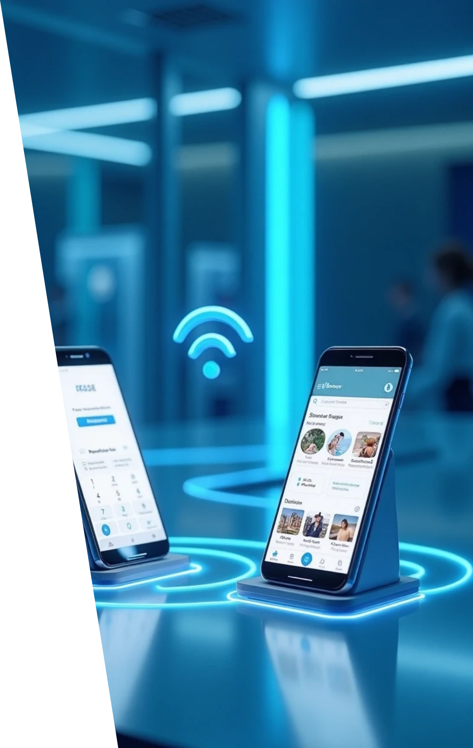




Applications of NFC
1
Mobile Payments
NFC is used in services like Apple Pay and Google Wallet, allowing users to make payments by tapping their phones.
2
Data Transfer
Users can share contacts, photos, and files by tapping devices together.
3
Access Control
NFC is used for secure entry systems, like hotel room keys and office access cards.

Slide 5

Types of NFC Devices
Active Devices: These can generate their own RF field and communicate (e.g., smartphones, payment terminals).
Passive Devices: These don’t have a power source and rely on the active device’s field (e.g., NFC cards, tags, e-passports).
Both types can store or share small pieces of data securely.

Slide 6


Components of NFC
NFC Controller (Chip) – Manages RF communication.
Antenna – Creates the electromagnetic field.
Secure Element (SE) – Stores payment or ID information safely.

Slide 7

Technical Specifications
Frequency: 13.56 MHz
Range: Up to 4 cm
Data Rate: 106–424 kbps
Communication: Half-duplex (one at a time)

Slide 8
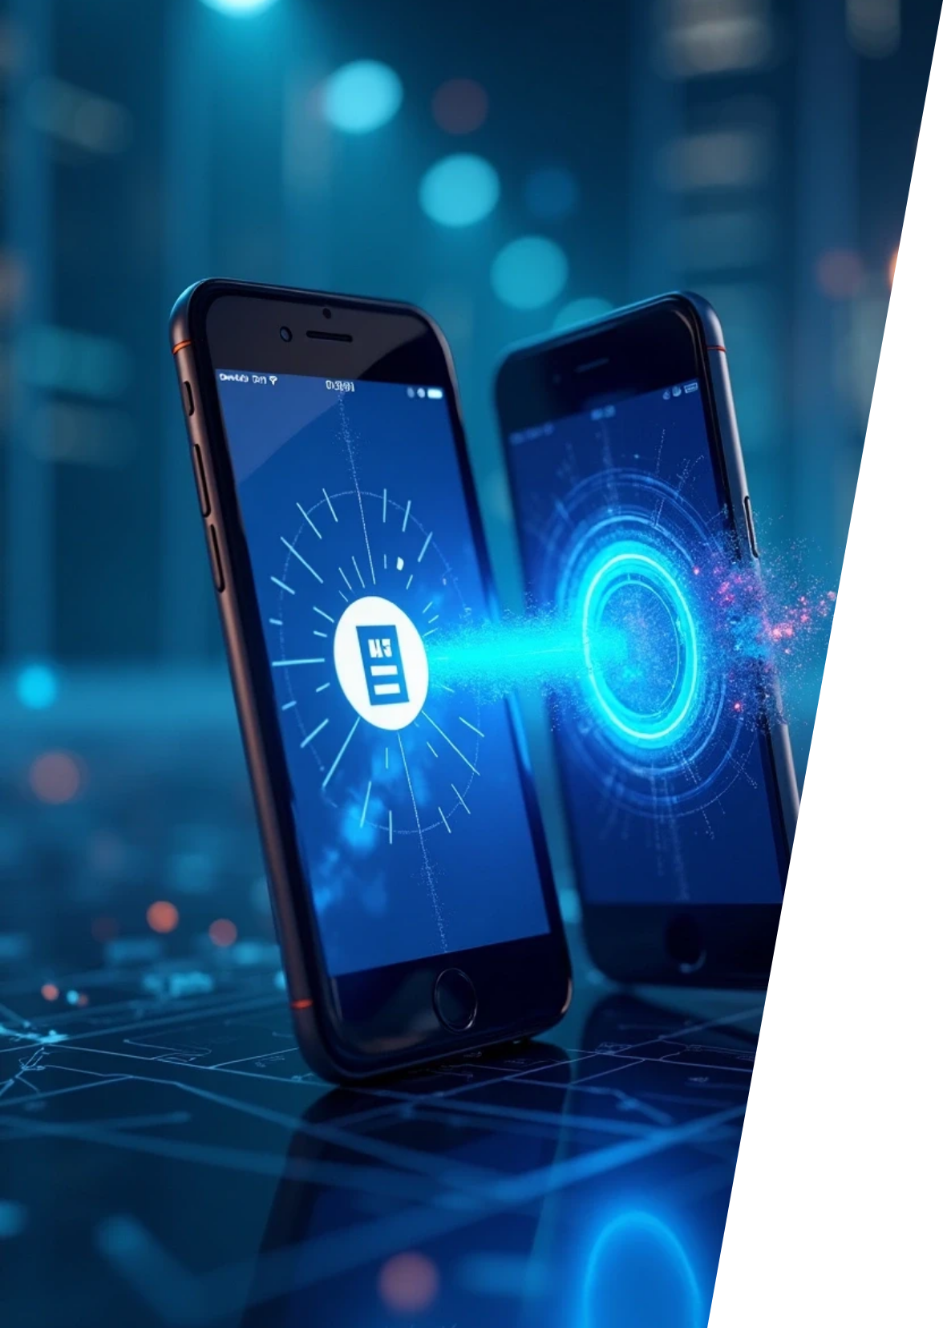

How NFC Works
Communication Modes
NFC includes three modes: peer-to-peer, card emulation, and reader/writer.
Data Exchange
In peer-to-peer mode, two devices can exchange data; in card emulation, a device mimics a smart card.
Connectivity
Devices can connect without any manual pairing, enhancing convenience for users.

Slide 9



Advantages of NFC
NFC, or Near Field Communication, offers several benefits that enhance security, convenience, and versatility in various applications. These advantages contribute to improved user experiences and broaden the technology's integration across devices.
Convenience
Users can complete transactions or share information with a simple tap, adding to the overall user experience.
2
Security
NFC uses encryption and tokenization, making transactions secure and reducing fraud risks.
1
Versatility
3
NFC can be integrated into various devices, such as smartphones, wearables, and smart cards.

Slide 10



Disadvantages of NFC
Limited Range
Compatibility Issues
Speed Limitations

Slide 11
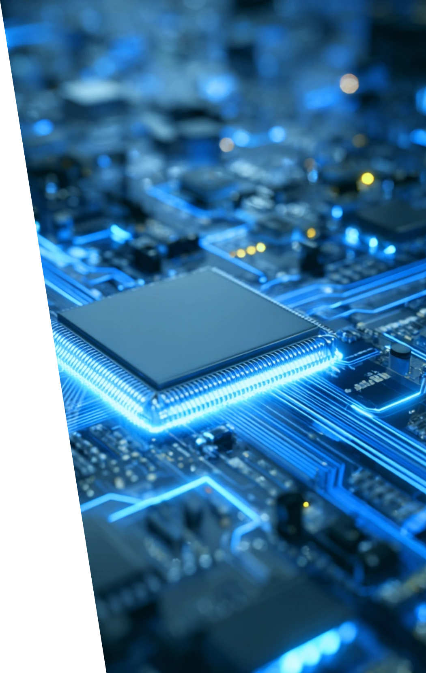

Future of NFC
Growing Popularity
The use of NFC is expected to expand with the rise of contactless payments and smart devices.
Integration with IoT
As the Internet of Things grows, NFC is likely to play a key role in connecting everyday devices seamlessly.
Innovative Uses
NFC technology may evolve into new areas, including smart advertising and enhanced user interactions in retail environments.

Slide 12
NFC in Transportation
Used for ticketing, fare payments, and access control in buses, metros, and airports.
It makes travel faster and smoother by reducing queues and eliminating paper tickets.

Slide 13
NFC in Education
NFC is used for attendance tracking, library book management, and digital student ID cards.
It improves security and saves time in school administration.

Slide 14
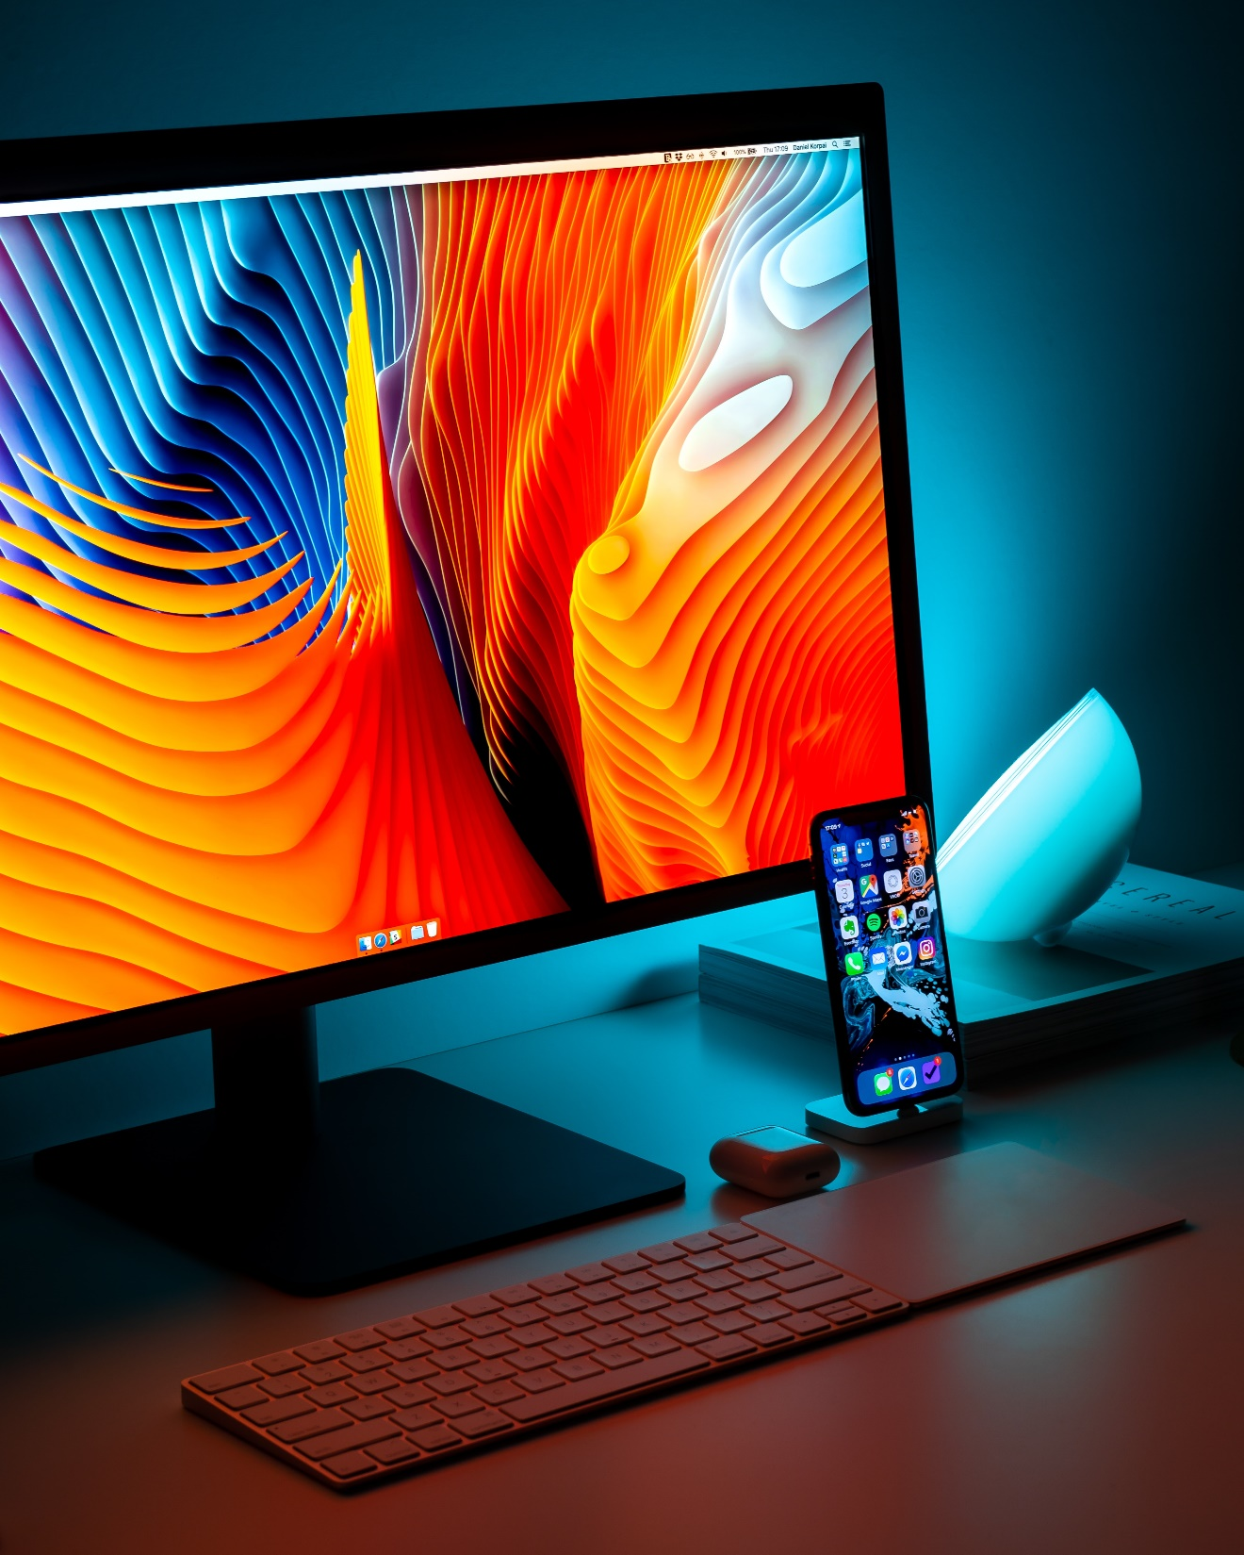
Market Growth of NFC
Smartphone Adoption:
Almost all modern smartphones now include NFC chips, which increases the number of users automatically.
Contactless Payments:
More people are using Google Pay, Apple Pay, and similar apps — boosting NFC-based transactions worldwide.
Smart Cities & Transport:
Public transport cards, metro passes, and access systems are switching to NFC for convenience.

Slide 15

Security in NFC
Encryption: Protects transmitted data.
User Authentication: Uses PIN, fingerprint, or face ID.
Secure Element: Stores sensitive data safely.
Short Range: Reduces hacking risk.

Slide 16
NFC in Mobile Devices
NFC (Near Field Communication) has become a standard feature in most modern smartphones.
It allows mobile devices to communicate wirelessly with other NFC-enabled devices, cards, or terminals by simply bringing them close together (within a few centimeters).
Every NFC-enabled smartphone has an NFC chip and an antenna coil built inside

Slide 17



Conclusion on NFC Technology
Importance
2
It enhances everyday activities such as payments and data exchanges.
Summary
1
NFC technology stands out for its simplicity, speed, and security.
Future Prospects
3
Understanding NFC is essential for innovative applications and technologies.

Slide 18


